Slide 1
TESTING TERMINOLOGIES

Slide 2
TESTING TERMINOLOGY
ERROR
FAULT
FAILURE
VALIDATION
VERIFICATION
TESTCASE

Slide 3
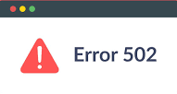
ERROR
AN ERROR IS A MISTAKE.
IT IS A MISCONCEPTION OR MISUNDERSTANDING ON THE PART OF A SOFTWARE DEVELOPER
IT IS DETERMINED BY DEVELOPERS
A requirements error may be magnified during design and still amplified during coding.
So, an error is a mistake during SDLC.

Slide 4
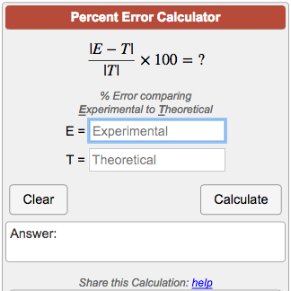
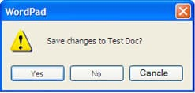
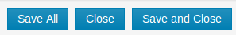
TYPES OF ERROR
SYNTACTIC ERROR
CALCULATION ERRORS
FLOW CONTROL ERROR
MISSPELLED WORD CANCEL SPELLED AS CANCLE
INCORRECT FORMULAS
IF A USER CLICKS ON ‘SAVE AND CLOSE’ BUTTON, THE USER INFORMATION IN THE FORM SHOULD BE SAVED AND THE FORM SHOULD CLOSE. IF CLICKING ON THE BUTTON DOES NOT CLOSE THE FORM, THEN IT IS A CONTROL FLOW ERROR.

Slide 5

DEFECT
FAULT OR DEFECT
A missing or incorrect statement in a program resulting from an error is a fault
DEFECT IS AN ERROR FOUND AFTER THE APPLICATION GOES INTO PRODUCTION.
IN OTHER WORDS DEFECT IS THE DIFFERENCE BETWEEN EXPECTED AND ACTUAL RESULT IN THE CONTEXT OF TESTING.
A fault is the representation of an error.
Representation here means the mode of expression, such as a narrative text, data flow diagrams, hierarchy charts, etc.
IT IS DETERMINED BY TESTERS

Slide 6
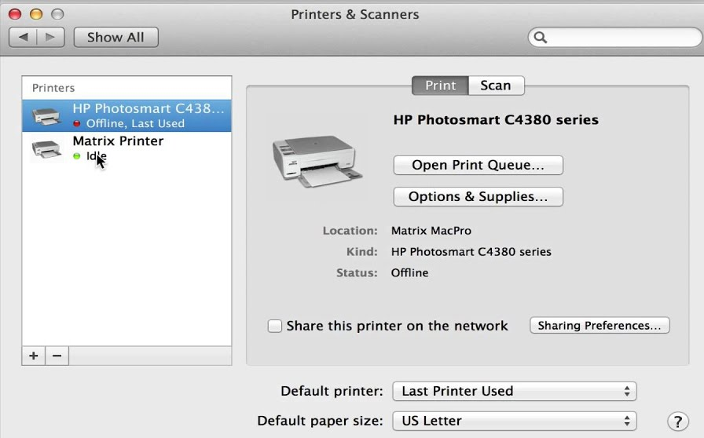
TYPES OF DEFECTS
LATENT DEFECT
A HIDDEN FLAW IN A SOFTWARE WHICH IS NOT IDENTIFIED BY THE USER UNTIL A SET OF OPERATIONS IS NOT PERFORMED.
SETTING DEFAULT PRINTER BY DOES NOT PRINT IN IT

Slide 7
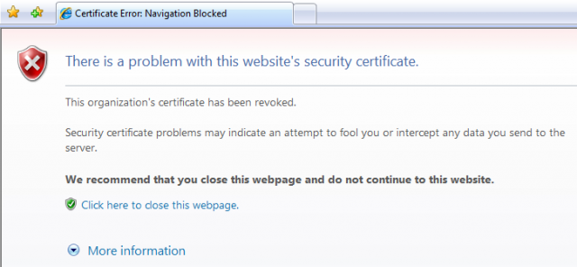
TYPES OF DEFECTS
LATENT DEFECT
MASKED DEFECT
A HIDDEN FLAW IN A SOFTWARE WHICH IS NOT IDENTIFIED BY THE USER UNTIL A SET OF OPERATIONS IS NOT PERFORMED.
SETTING DEFAULT PRINTER BY DOES NOT PRINT IN IT
IT DOES NOT CAUSED ANY FAILURE AS IT IS COVERED OR MASKED BY ANOTHER DEFECT.
IN PAGE NAVIGATIONS WHEN THERE IS A DEFECT IN ONE PAGE, IT PREVENTS THE TEAM TO MOVE TO ANOTHER.

Slide 8

TYPES OF DEFECTS
LATENT DEFECT
MASKED DEFECT
DEFECT CASCADING
A HIDDEN FLAW IN A SOFTWARE WHICH IS NOT IDENTIFIED BY THE USER UNTIL A SET OF OPERATIONS IS NOT PERFORMED.
SETTING DEFAULT PRINTER BY DOES NOT PRINT IN IT
IT DOES NOT CAUSED ANY FAILURE AS IT IS COVERED OR MASKED BY ANOTHER DEFECT.
IN PAGE NAVIGATIONS WHEN THERE IS A DEFECT IN ONE PAGE, IT PREVENTS THE TEAM TO MOVE TO ANOTHER.
WHEN A DEFECT IS NOT IDENTIFIED IN TESTING, IT INVOKES OTHER DEFECTS. AS A RESULT, MULTIPLE DEFECTS CROP UP IN THE LATER STAGES.
DEFECT UNIDENTIFIED IN CALCULATING SALARIES MAY REFLECT IN BALANCE SHEET, TAX CALCULATIONS, AND ANNUAL SALARY CALCULATIONS

Slide 9
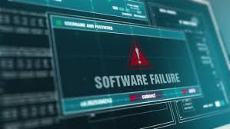
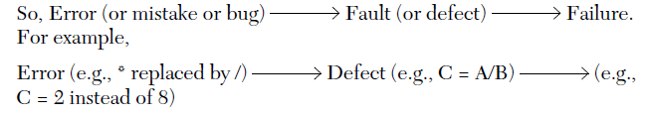
FAILURE
FAILURE OCCURS WHEN THE SOFTWARE FAILS TO PERFORM IN THE REAL ENVIRONMENT.
Occurs when a fault executes
IT IS THE OBSERVABLE INCORRECT BEHAVIOR OF THE SYSTEM.
The manifested inability of a system or component to perform a required function within specified limits is known as a failure.
IT IS DETERMINED BY CUSTOMERS - dynamic process

Slide 10
EXAMPLES OF FAILURES
ANY PHYSICAL DAMAGE OR OVERHEATING IN THE HARDWARE CAN CAUSE THE WHOLE SYSTEM TO FAIL.
IF THE SOFTWARE IS NOT COMPATIBLE WITH THE HARDWARE.
FAILURES ALSO HAPPEN BY ENVIRONMENTAL CONDITIONS LIKE A RADIATION BURST, A STRONG MAGNETIC FIELD, ELECTRONIC FIELDS, OR POLLUTION COULD CAUSE FAULTS IN HARDWARE OR SOFTWARE.

Slide 11
Incident:
An incident is the symptom associated with a failure that alerts the user to the occurrence of a failure.
It is an unexpected occurrence that requires further investigation.
It may not need to be fixed.
Test:
Concerned with errors, faults, failures, and incidents.
A test is the act of exercising software with test cases.
Two distinct goals—to find failures or to demonstrate correct execution.

Slide 12
VERIFICATION
ARE WE BUILDING THE SYSTEM RIGHT ?
ENSURES THAT THE SYSTEM DEVELOPED IS ERROR FREE WITHOUT DEFECTS (I.E., DOES NOT MEAN THAT IT NEED TO SATISFY THE REQUIREMENT SPECIFICATION)

Slide 13
VALIDATION
ARE WE BUILDING THE RIGHT SYSTEM ?
ENSURE THE SYSTEM IS DELIVERED AS PER THE REQUIREMENT OF THE CUSTOMER (I.E., MEETING THE REQUIREMENT SPECIFICATION)

Slide 14
Verification vs VALIDATION
ASSUME THAT YOU GO TO A HOTEL AND ORDER A BUTTERSCOTCH MILKSHAKE WHICH IS YOUR FAVORITE MENU.
ONCE YOU RECEIVE THE ORDERED YOU SHALL LOOK FOR THE COLOR, AROMA AND LOOK FOR BUTTERSCOTCH TOPPINGS AND CONFIRMS THAT IT’S A BUTTERSCOTCH MILKSHAKE.
THIS IS CALLED AS VERIFICATION
ONCE YOUR VERIFICATION IS DONE IT DOES NOT MEAN THAT IT IS AN 100% BUTTERSCOTCH MILKSHAKE.
Let see how?

Slide 15
Verification vs VALIDATION
ASSUME THAT YOU GO TO A HOTEL AND ORDER A BUTTERSCOTCH MILKSHAKE WHICH IS YOUR FAVORITE MENU
THE MILKSHAKE THAT YOU OBTAINED COULD BE SIMILAR LIKE THE ORIGINAL, BUT WHAT IF THE TASTE OF IT VARY.
TASTING THE MILKSHAKE AND CONFIRMING IT AS A BUTTERSCOTCH MILKSHAKE.
THIS IS CALLED AS VALIDATION.

Slide 16
Verification vs VALIDATION
CONSIDER THE DEVELOPMENT OF USER INTERFACE
THE MENUS AND BUTTONS ARE BE MADE IN THE USER INTERFACE DESIGN AND APPROACHES FOR TESTING
What is Verification?
&
What is Validation?

Slide 17
Verification vs VALIDATION
CONSIDER THE DEVELOPMENT OF USER INTERFACE
DETERMINING AND UPDATING THE SYNTACTIC ERROR (MISSPELLED WORK) IS VERIFICATION
DETERMINING WEATHER THE WORDPAD IS SAVED ON CLICK YES AND DISCARDED ON CLICKING NO IS CALLED AS VALIDATION

Slide 18
TESTCASE
INPUT TO TEST THE SYSTEM
ENSURE THE CORRECT WORKING OF THE FUNCTIONALITY BY EXECUTING PROGRAM ELEMENTS(I.E., PRE CONDITIONS, POST CONDITIONS, TEST PROCEDURE, ETC.,) .
ALSO DETERMINE THE STATE OF SOFTWARE
A test case has an identity and is associated with program behavior.
A test case also has a set of inputs and a list of expected outputs.
The essence of software testing is to determine a set of test cases for the item to be tested.

Slide 19
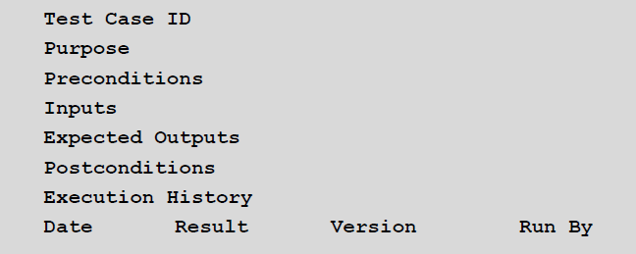
Test case template

Slide 20
There are 2 types of inputs:
a. Preconditions: Circumstances that hold prior to test case execution.
b. Actual inputs: That were identified by some testing method.
Expected outputs are also of two types:
a. Post conditions
b. Actual outputs
Test cases need to be developed, reviewed, used, managed, and saved.

Slide 21
TESTCASE EXAMPLE
TEST CASES TO CHECK VALIDATE THE PASSWORD HAVING 7 SEVEN CHARACTERS, WITH FIRST CHARACTER NUMERIC AND REMAINING ALPHA NUMERIC
TESTCASE | INPUT VALUE | EXPECTED RESULT | ACTUAL RESULT | TEST OUTCOME
CASE -1 (POSITIVE CASE) | 4TEST64 | PASSWORD SHOULD ACCEPT AND PROCEED TO LOGIN | PASSWORD ACCEPTED AND LOGGED IN | TEST CASE PASSED
CASE -2 (NEGATIVE CASE) * | TEST464 | PASSWORD SHOULD NOT ACCEPT AND ASK TO RE-LOGIN | PASSWORD ACCEPTED AND LOGGED IN | TEST CASE FAILED AS MISMATCH IN ACTUAL & EXPECTED RESULTS
* IN CASE 2 TEST CASE FAILED BECAUSE THE FIRST CHARACTER OF INPUT SHOULD BE NUMERIC

Slide 22
Test suite:
A collection of test scripts or test cases that is used for validating bug fixes (or finding new bugs) within a logical or physical area of a product.
Test script:
The step-by-step instructions that describe how a test case is to be executed.
Test ware:
It includes all of testing documentation created during the testing process.
For example, test specification, test scripts, test cases, test data, the environment specification.
Test oracle: Any means used to predict the outcome of a test.
Test log: A chronological record of all relevant details about the execution of a test.
Test report: A document describing the conduct and results of testing carried out for a system.

Slide 23
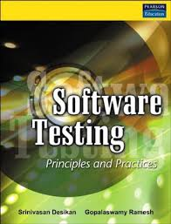
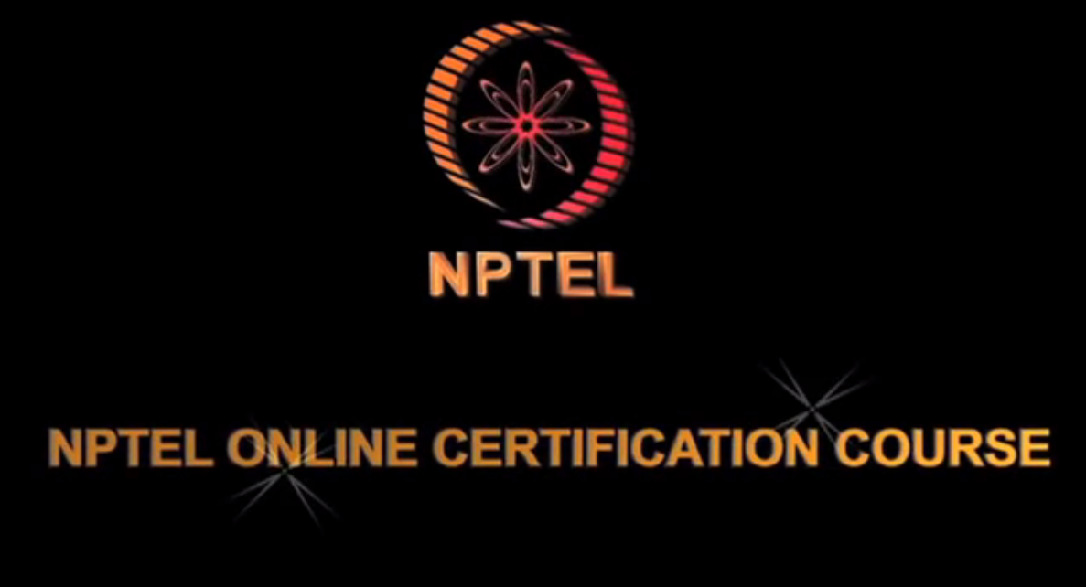




REFERENCES

